Slide 1

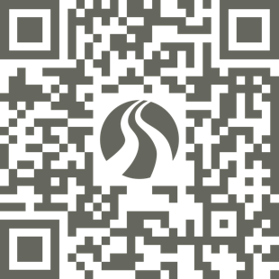
GET A
GUARANTEED SCHOLARSHIP!
BYU-Pathway Worldwide is now offering students who apply by August 22 a guaranteed tuition discount!
byupathway.org
All students enrolled in BYU-Pathway's PathwayConnect
are eligible for a tuition discount.

