Slide 1
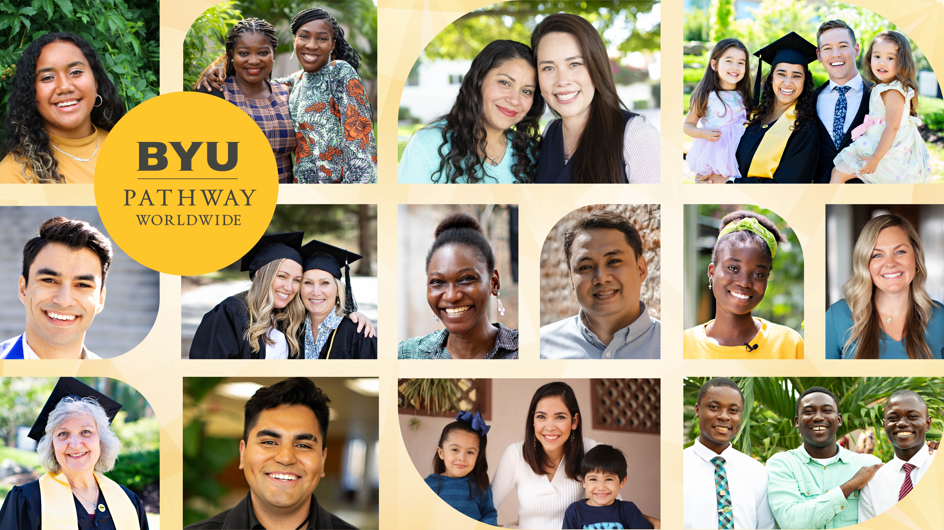

Slide 2

The mission of BYU-Pathway Worldwide is to develop disciples of Jesus Christ who are leaders in their homes, the Church, and their communities.
Notes:
We believe we are all children of God with divine potential, and BYU-Pathway is committed to making education available all over the globe. BYU-Pathway provides access to online degrees from BYU-Idaho and Ensign College.
[Please see end of presentation for mission statement slides with other photo options]

Slide 3





Institutions of Higher Education in the Church Educational System
BYU-Pathway Worldwide provides global access to online degrees from BYU-Idaho and Ensign College.
Notes:
BYU-Idaho and Ensign College award certificates and accredited online degrees, build courses, and hire and support instructors who are experts in online course delivery.
BYU-Pathway provides the access, support, and resources tailored to help online students succeed.

Slide 4
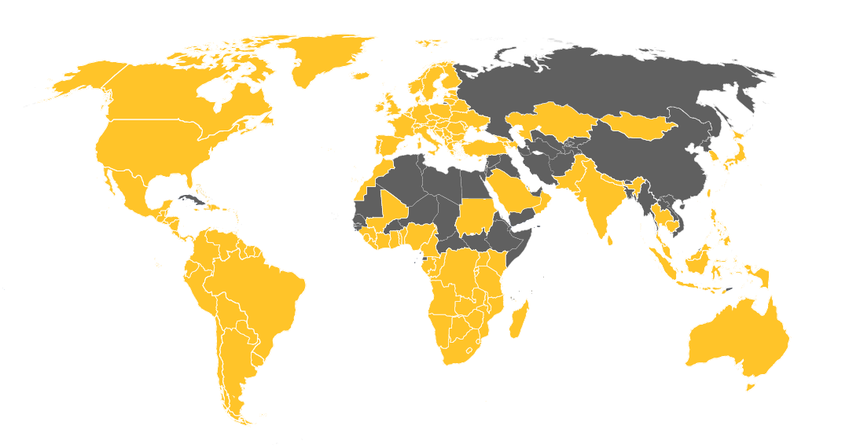
BYU-Pathway provides access to online degrees from U.S.-accredited CES universities
75,000
STUDENTS SERVED
180⁺
COUNTRIES
BYU-Pathway
available in-country
Notes:
BYU-Pathway provides access to online certificates and degrees from U.S.-accredited universities BYU-Idaho and Ensign College.
Use annual numbers from https://www.byupathway.edu/facts-stats.

Slide 5
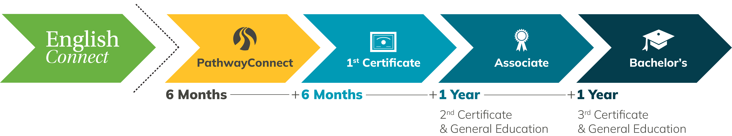
A Degree in Three Years
Learn English in one year or less
Finish faster
No elective credits
Focus on major courses and marketable skills
Notes:
Finish faster with three-year bachelor's degrees that keep core courses and eliminate elective credits. Three certificates build into an associate degree and a bachelor’s degree and focus on helping you gain job skills.
PathwayConnect + three certificates + associate degree = three-year bachelor's degree (90–96 credits)
Students progressively build skills on the way to a degree.
Students without intermediate-level English can join EnglishConnect. They’ll take three courses to learn English in one year and prepare for higher education.
PathwayConnect is the recommended start to every degree.
Six foundational courses taught over three blocks.
BLOCK = 7-week period of classes
Students participate in weekly gatherings to support each other, discuss course assignments, practice skills, learn leadership, and strengthen faith.
Teaches soft skills like professional communication, developing a growth mindset, leadership, teamwork, time management, overcoming thinking errors, etc.
No secondary school completion required (for age 18+)
English assessment is required because all courses are in English
A bachelor’s degree is made up of three certificates.
5–7 courses = 1 certificate
2 certificates + general ed + religion = associate degree
3 certificates + general ed + religion = bachelor’s degree
Benefits of certificates:
QUICK: Takes 1 year or less to complete each one
PRACTICAL: Learn job-specific skills at each level
HELPFUL: Find a better job before graduating
BENEFICIAL: Improve pay along the way

Slide 6


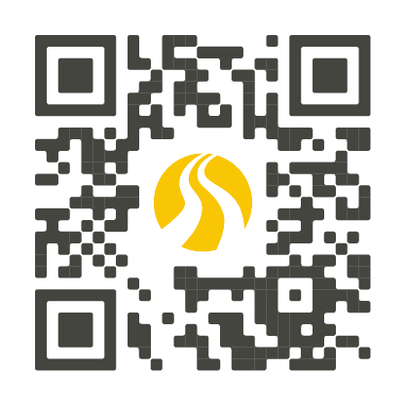
Certificates & Degrees
DEGREES
CERTIFICATES
Accounting*
Applied Business Management
Software Development
Information Technology
Applied Health
Communication
Family and Human Services
Family History Research*
Professional Studies
Administrative Assistant
Advanced Family History Research
Basic Accounting
Business Administration
Business & Leadership Skills
Commercial Fundamentals
Communication Core
Communication Fundamentals
Community & Environmental Health
Entrepreneurship
Family History Research
Family Relations
Family Services
Family Theory & Research
Graphic Design Fundamentals
Health Program Evaluation
Health Program Strategies
Hospitality & Tourism Management
IT Fundamentals
Medical Billing & Coding Fundamentals
Project Management
Social Media Marketing
Software Development
System Administration
Technical Support Engineer
TEFL
Web & Computer Programming
Web Development
*Associate degree only
byupathway.edu/
degrees/program-list
Notes:
BYU-Pathway offers online certificates and degrees in the business, technology, health, communication fields, and more.

Slide 7
Current Programs
byupathway.edu/degrees/program-list
Notes:
Can use this if the QR code on the previous slide doesn’t scan.

Slide 8
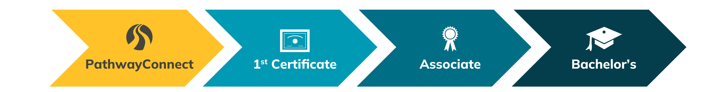
Build a Degree with Certificates
Example Bachelor’s Degree
Information Technology
1st Certificate:
Technical Support Engineer
2nd Certificate:
IT Fundamentals
3rd Certificate:
System Administration
+ General Education and Religion Courses

Slide 9


Low Tuition & Guaranteed Discounts
Nigeria
$328
USD
Total cost of a bachelor’s degree
Returned Missionary Scholarship
$4 USD/credit
Heber J. Grant
Tuition Discount
25% Discount
Tuition is paid each term
10–50% discount
Notes:
TOTAL COST OF DEGREE VERSION. Use this or the per-credit version on the next slide.
Note: This slide is currently for Nigeria. When presenting, you can look up the current rate at https://www.byupathway.edu/tuition and translate to that country’s currency.
We recommend showing a per credit or max total degree cost (based on 96 credits). Costs can vary depending on courseload.
2025–26 Tuition Rate
($4 tuition rate) x (90–96 credits) = $360–384
($4 tuition rate) x (14 free religion credits) = $56
($360–384 credit total) – ($56 free religion) = $304–328 degree total
w/ 10% minimum tuition discount = $274–295 degree total

Slide 10

Low Tuition & Guaranteed Discounts
United States
$86
USD
Cost per credit
Returned Missionary Scholarship
Bachelor’s degree = $7,000 USD
Heber J. Grant
Tuition Discount
25% Discount
Tuition is paid each block
10–50% discount
Notes:
PER CREDIT VERSION. This features the price in the United States. When presenting, you can look up the current rate at https://www.byupathway.edu/tuition and translate to that country’s currency.
*Students who start with the advanced path (bypassing PathwayConnect) pay a higher rate of $147 USD per credit.
We recommend showing a per credit or total degree cost (based on 96 credits). Term costs can vary depending on student load.
2025–26 Tuition Rate
($86 tuition rate) x (90–96 credits) = $7,740–$8,256
($86 tuition rate) x (14 free religion credits) = $1,204
($7,740–$8,256 credit total) – ($1,204 free religion) = $6,536–7,052 degree total
w/ 10% minimum tuition discount = $5,882–6,347 degree total

Slide 11
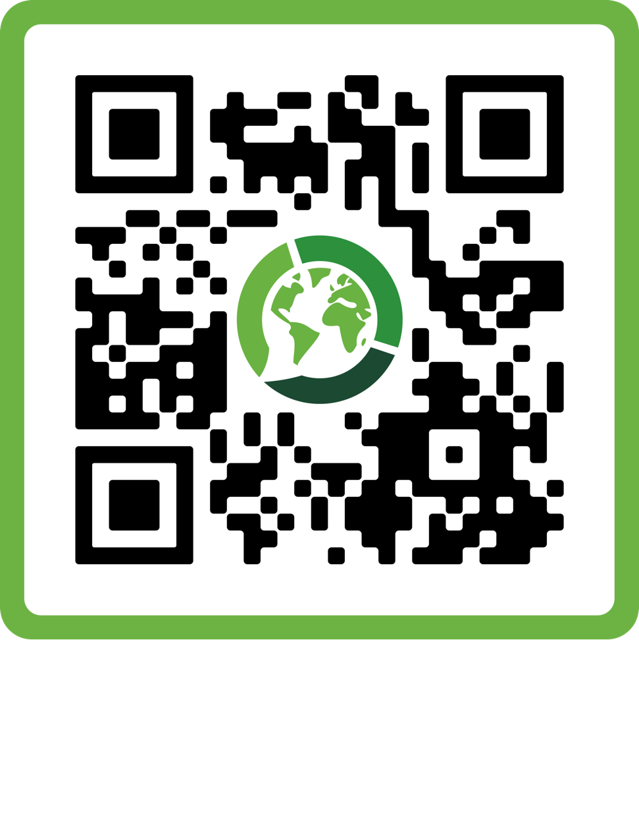
Interested in EnglishConnect?
bit.ly/EnglishConnectRFI
Notes:
Note: An EnglishConnect slide deck section is included at the bottom of the presentation.

Slide 12
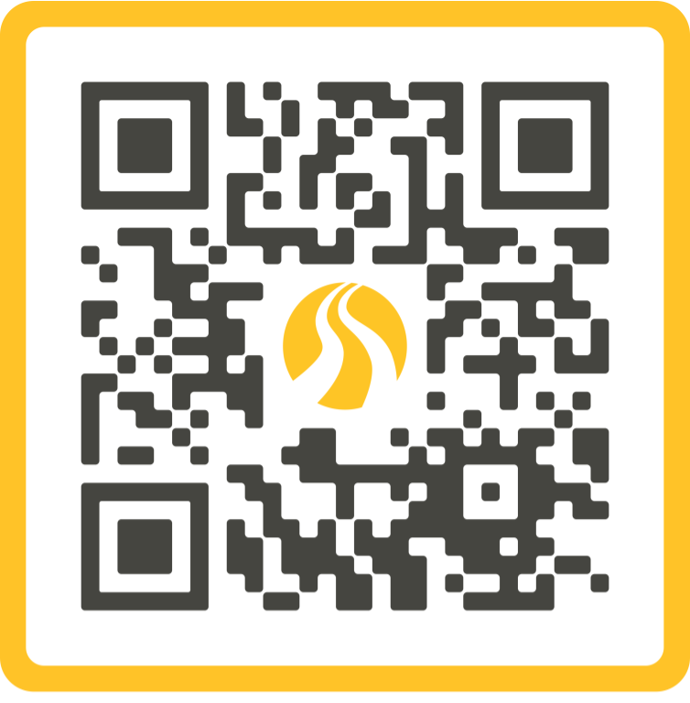
Interested in BYU-Pathway?
byupathway.edu/request-info

Slide 13



How Students Get Jobs
Our certificates and degrees help you quickly gain marketable skills so you can get a better job before graduating.
LOCAL EMPLOYMENT
REMOTE JOBS
ENTREPRENEURSHIP
Notes:
BYU-Pathway helps connect students with remote job opportunities so they can become self-reliant, support their families, serve, and build up their own communities.

Slide 14

Examples of Remote Jobs
Accounting | Human resources
Computer programming | Market research
Customer care | Quality control
Customer sales | Reception and routing
Data entry | Social media marketing
Financial analysis | Technical support
Graphic design | Web development

Slide 16
The mission of BYU-Pathway Worldwide is to develop disciples of Jesus Christ who are leaders in their homes, the Church, and their communities.
Notes:
(Image for an institutional presentation) We believe we are all children of God with divine potential, and BYU-Pathway is committed to making education available all over the globe. BYU-Pathway provides access to online degrees from BYU-Idaho and Ensign College.

Slide 17

The mission of BYU-Pathway Worldwide is to develop disciples of Jesus Christ who are leaders in their homes, the Church, and their communities.
Notes:
We believe we are all children of God with divine potential, and BYU-Pathway is committed to making education available all over the globe. BYU-Pathway provides access to online degrees from BYU-Idaho and Ensign College.

Slide 18
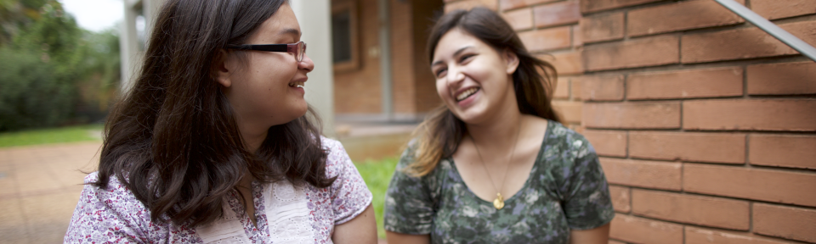
The mission of BYU-Pathway Worldwide is to develop disciples of Jesus Christ who are leaders in their homes, the Church, and their communities.
Notes:
We believe we are all children of God with divine potential, and BYU-Pathway is committed to making education available all over the globe. BYU-Pathway provides access to online degrees from BYU-Idaho and Ensign College.

Slide 19

The mission of BYU-Pathway Worldwide is to develop disciples of Jesus Christ who are leaders in their homes, the Church, and their communities.
Notes:
We believe we are all children of God with divine potential, and BYU-Pathway is committed to making education available all over the globe. BYU-Pathway provides access to online degrees from BYU-Idaho and Ensign College.

Slide 20
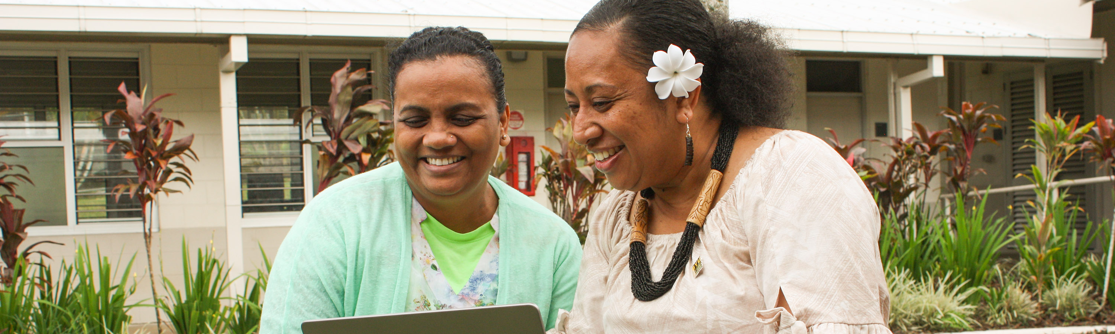
The mission of BYU-Pathway Worldwide is to develop disciples of Jesus Christ who are leaders in their homes, the Church, and their communities.
Notes:
We believe we are all children of God with divine potential, and BYU-Pathway is committed to making education available all over the globe. BYU-Pathway provides access to online degrees from BYU-Idaho and Ensign College.

Slide 21
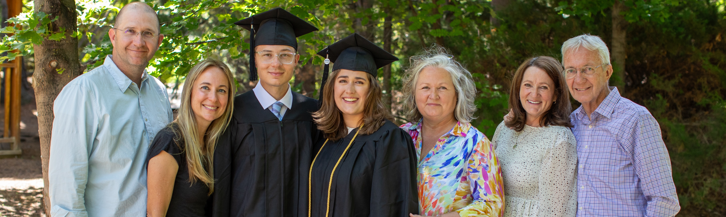
The mission of BYU-Pathway Worldwide is to develop disciples of Jesus Christ who are leaders in their homes, the Church, and their communities.
Notes:
We believe we are all children of God with divine potential, and BYU-Pathway is committed to making education available all over the globe. BYU-Pathway provides access to online degrees from BYU-Idaho and Ensign College.

Slide 22
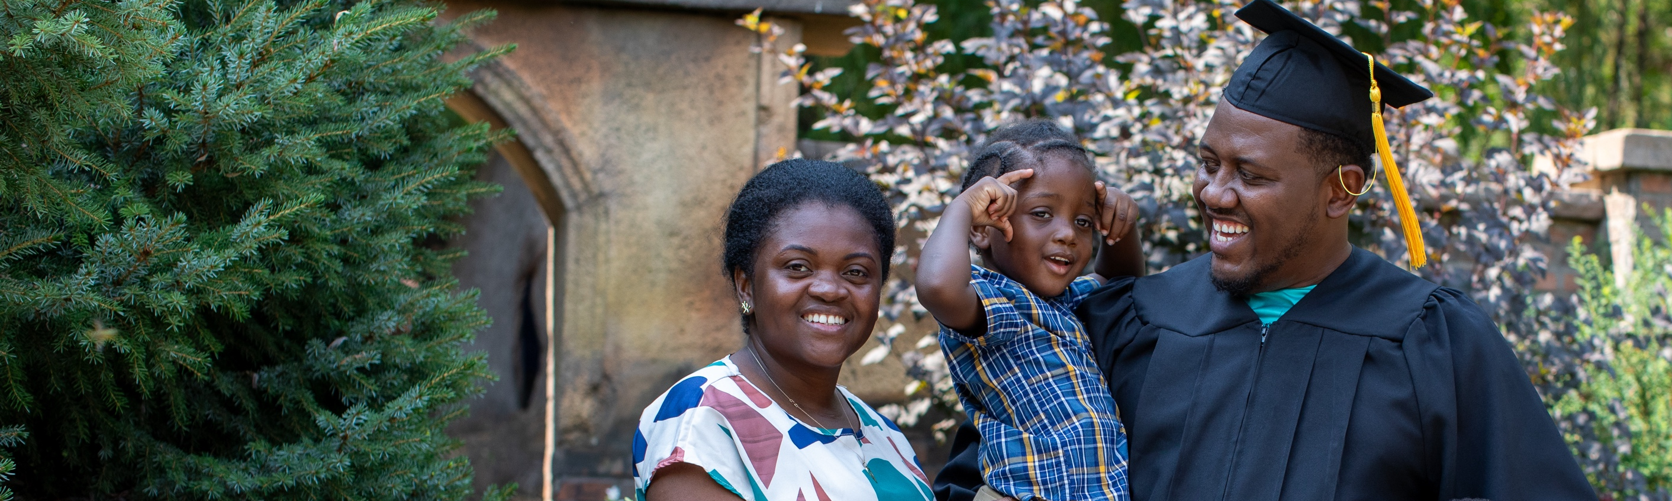
The mission of BYU-Pathway Worldwide is to develop disciples of Jesus Christ who are leaders in their homes, the Church, and their communities.
Notes:
We believe we are all children of God with divine potential, and BYU-Pathway is committed to making education available all over the globe. BYU-Pathway provides access to online degrees from BYU-Idaho and Ensign College.

Slide 23




Who BYU-Pathway serves
74,839
STUDENTS
SERVED
180⁺
International
(50,576 students)
Countries
U.S. & Canada
(24,160 students)
Gender
52%
48%
Female
Male
2024 annual data
Notes:
BYU-Pathway is growing rapidly, serving more than 75,000 students in 2024, in all 50 states and 180 countries worldwide.

Slide 24

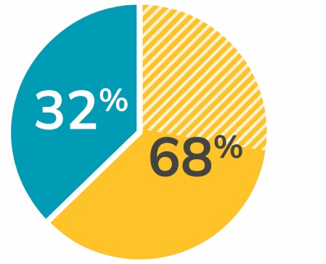






74,839
180+
students served in 2024
countries
Worldwide Student Population
Top 5 Highest-enrolling Countries
U.S./Canada
Nigeria: 11,724
Brazil: 2,488
International
Ghana: 4,211
Mexico: 2,090
Africa
Philippines: 3,852
2024 annual data

Slide 25
A Degree in Three Years
Finish faster
No elective credits
Focus on major courses and marketable skills
EVERY STEP = BETTER JOB OPPORTUNITIES
Notes:
Finish faster with three-year bachelor's degrees that keep core courses and eliminate elective credits. Three certificates focused on helping you gain job skills build into an associate degree as well as a bachelor’s degree. Students start their first certificate course just 14 weeks into their educational journey.
PathwayConnect + three certificates = three-year bachelor's degree (90–96 credits)
PathwayConnect teaches soft skills like professional communication, developing a growth mindset, leadership, teamwork, time management, overcoming thinking errors, etc.
Certificates teach marketable skills designed to help students improve employment before graduating.

Slide 26
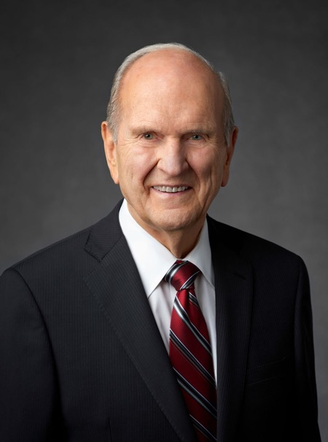
“In the Church, obtaining an education
and getting knowledge are a religious responsibility. We educate our minds so
that one day we can render service of worth to somebody else.”
PRESIDENT RUSSELL M. NELSON
“Focus on Values,” New Era, Feb. 2013

Slide 27


Earn a degree and build faith
Students will build hope and confidence
through faith-based academic courses
and free religion courses.
91%
of students increase their testimony of Jesus Christ
Notes:
All the courses BYU-Pathway students take are founded on the gospel of Jesus Christ. Students also take religion courses throughout their degree [through Seminaries & Institutes of Religion], which help them strengthen their faith in Jesus Christ.

Slide 28

Through a BYU-Pathway Worldwide education, students discover new light and hope as they become self-reliant disciples of Jesus Christ and make covenants with Him.
“BYU-Pathway will be everywhere. There will be light all over the earth, and people will see it in BYU-Pathway students. They’ll be drawn to the light to seek an education, to change the world.”
— ELDER KIM B. CLARK
Emeritus General Authority Seventy and former Commissioner of the
Church Educational System

Slide 29
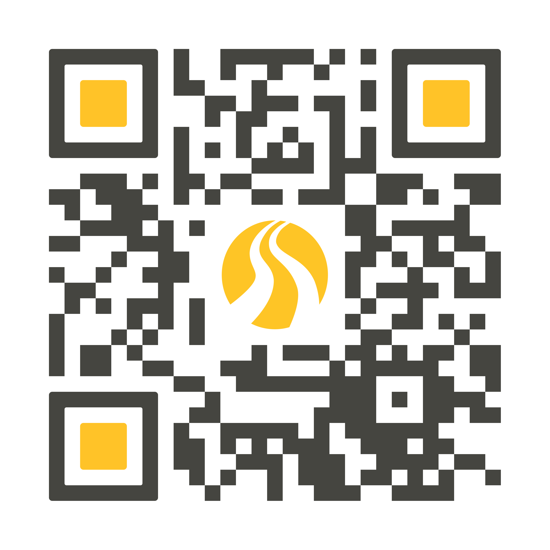
Apply for Remote Jobs
companion.byupathway.edu
Notes:
As students complete a job profile in the Companion app, they gain access to available job listings and consent to have their information shared with employers, who may contact them directly. BYU-Pathway is actively working to expand opportunities with additional employers.
Coordinate with Lindsey Williams (lwilliams@byupw.edu) with questions.

Slide 30
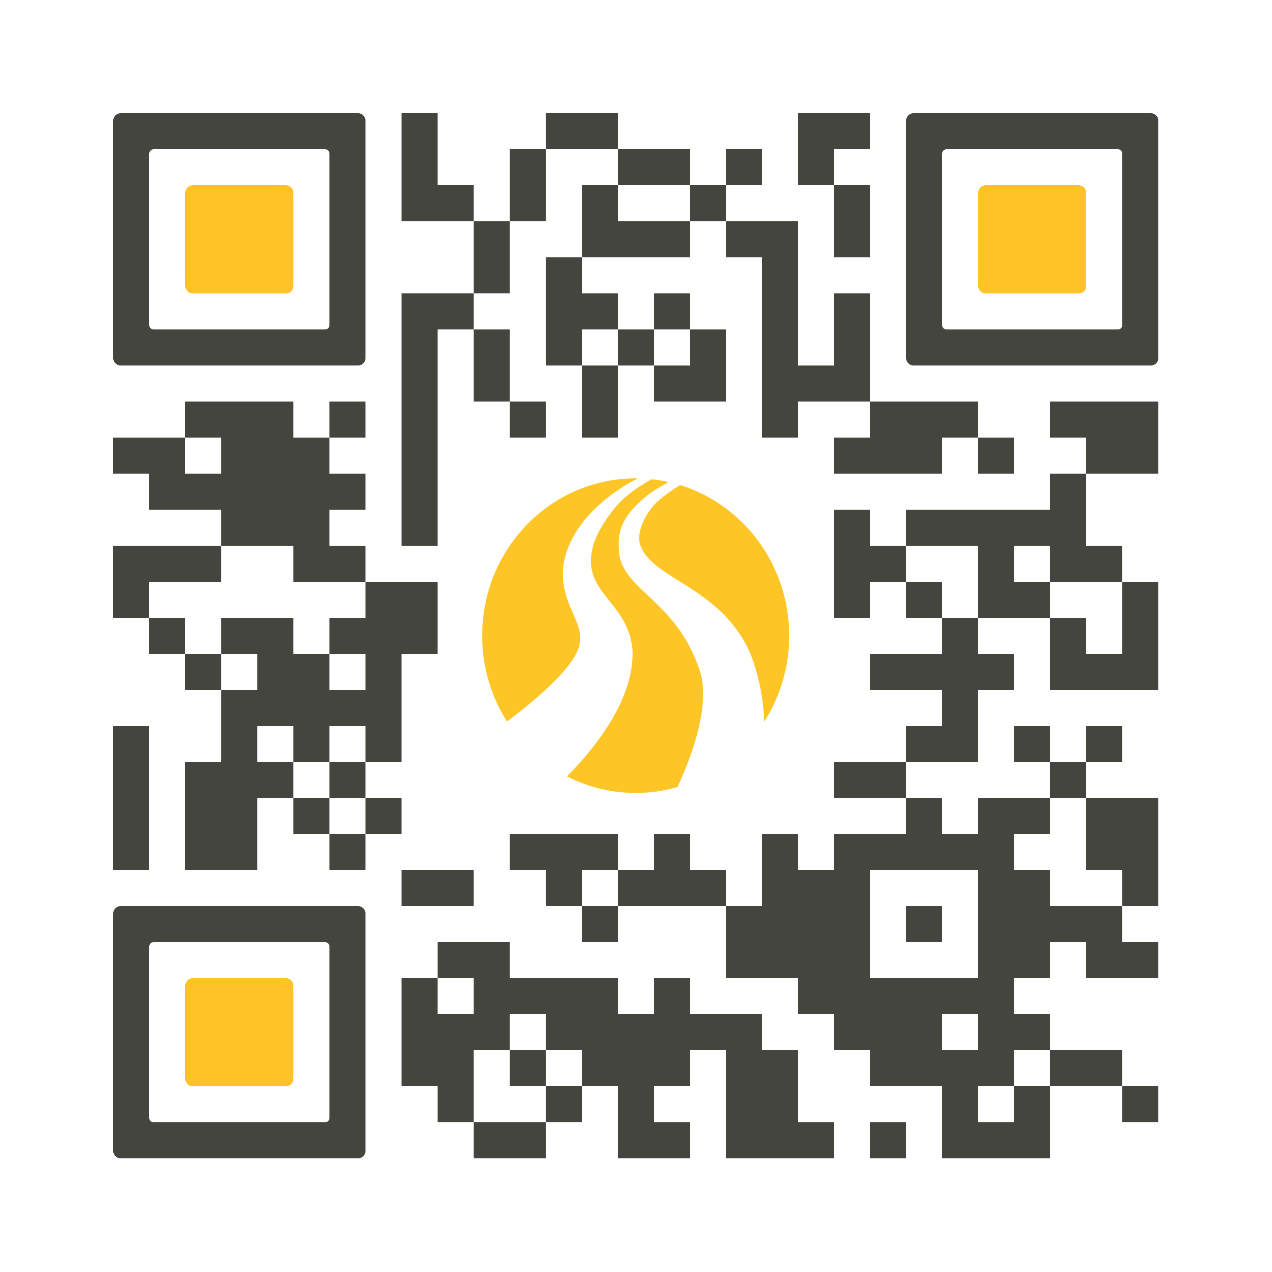
Sign Up for Career Zoom Chats
Bit.ly/zoomurl
Notes:
To schedule a Career Zoom chat and get a unique QR code and shortened URL for your area, please contact Makenzie Stevens at mstevens@byupw.edu.
SWITCH OUT QR CODE PER AREA - CHANGE

Slide 31
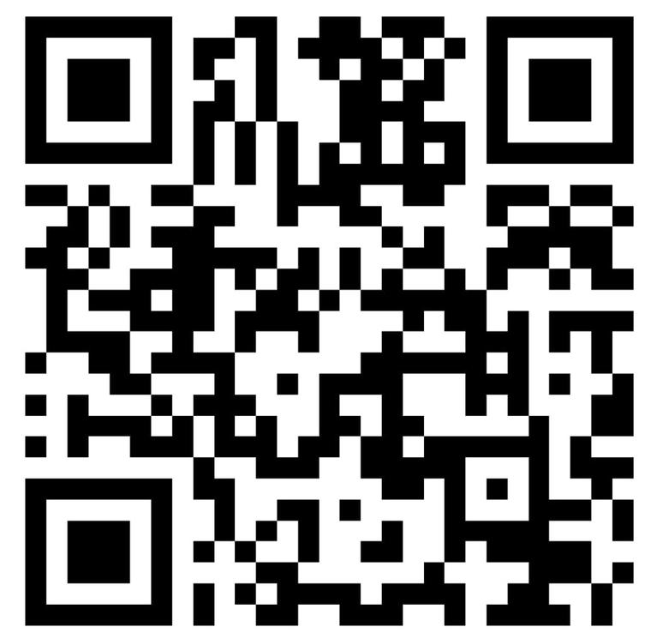
Apply for a Laptop
Laptops come from the Help Start Education Foundation
CRITERIA
Have completed PC 101
Currently registered with
BYU-Pathway
Looking for a job
Willing to attend the weekly career chats
Notes:
To learn more about the foundation, visit HelpStart.org.

Slide 33



EnglishConnect is an English-language-learning program provided by
The Church of Jesus Christ of Latter-day Saints.
Its purpose is to help participants expand opportunities by developing
English skills in an environment of faith, fellowship, and growth.
Increase faith in
Jesus Christ
Become a more capable learner
Develop English skills
Notes:
In EnglishConnect, learners complete personal study, conversation groups, and daily practice to learn English.
Personal study:
Study a spiritual principle of learning
Memorize vocabulary
Practice communication patterns
Conversation groups:
Discuss the principle of learning
Create conversation using communication patterns
Evaluate your progress and prepare for the next week
Daily practice:
Add English to your daily activities
Pray often about how to improve

Slide 34

Levels and audiences
EnglishConnect has multiple levels to help learners progress.
EnglishConnect 1 and 2 are free and help learners develop basic English skills.
EnglishConnect 3 is low-cost and prepares learners for workplace and academic opportunities — especially BYU-Pathway Worldwide.
All are invited: ages 11+, members of the Church, and friends of the Church.

Slide 35

Prepare for BYU-Pathway Worldwide
After earning an EnglishConnect 3 completion certificate, learners can waive the English entrance exam for BYU-Pathway Worldwide and be prepared to be successful in their courses.

Slide 36

“EnglishConnect has not only taught me English but also responsibility, commitment, and how to be an agentive learner. It has even given me much more confidence than I had before.”
Dinah Boiser
Philippines

Slide 37

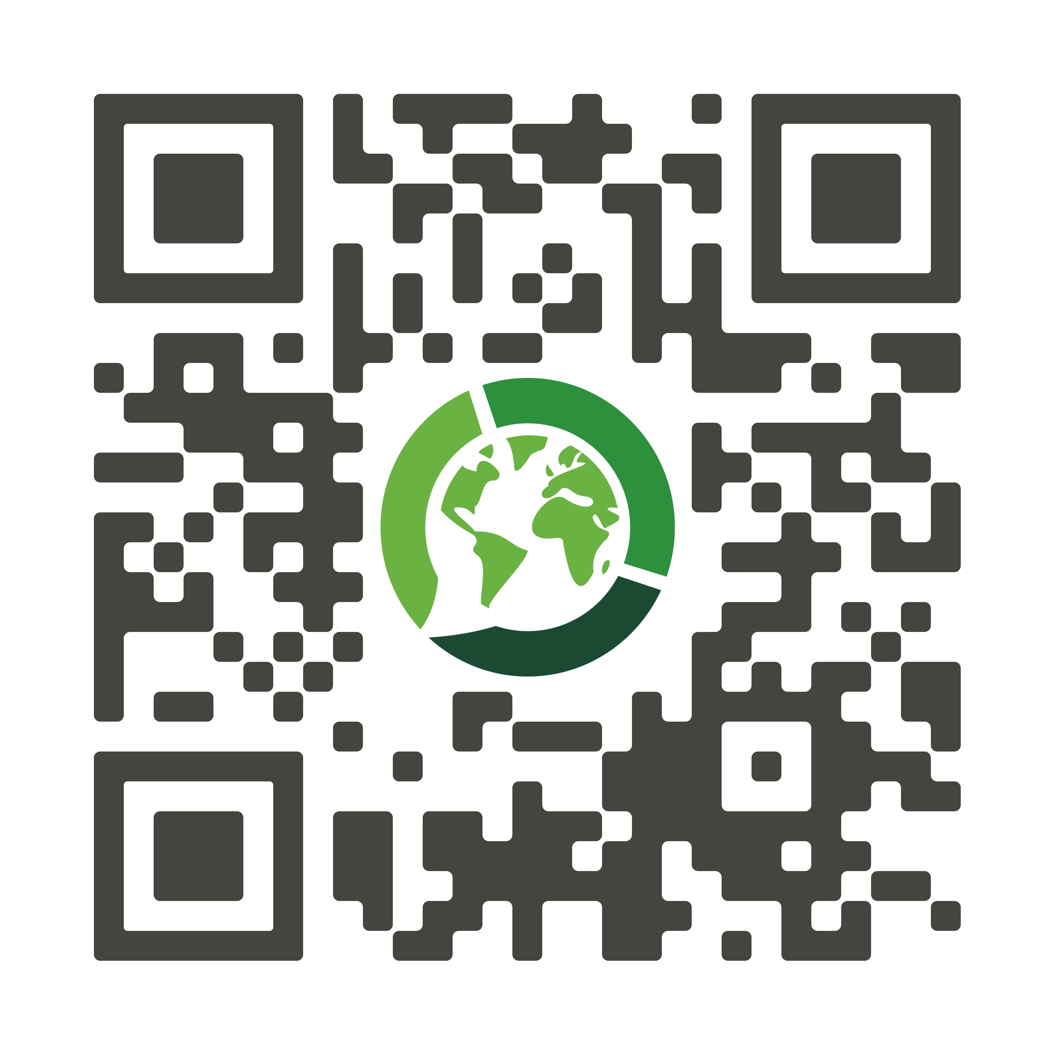
Scan to get started!
englishconnect.org/get-started

